Slide 1
Google Play store Data cRAwl
A Presentation by G-miners
Group member: Govind Yatnalkar
Mentor/ guide: Dr. haroon malik
Date: November 8th 2018
College of engineering & technology Marshall university

Slide 2
Agenda…
Purpose of the Project
The Required Libraries
Architecture of the Proposed Crawler
Data Extraction Steps
The Code Base (Work Done Till Now)
Future Work

Slide 3


1. Purpose of the project
The main purpose – valued data extraction from raw data.
Save the data and proceed with some analysis.

Slide 4



2. The Required libraries
Beautiful Soup For Data Crawl
MySQL Connector for Establishing a connection between MySQL and Python Code.
Request for opening the URL and data transfer
LXML library for parsing HTML content.

Slide 5
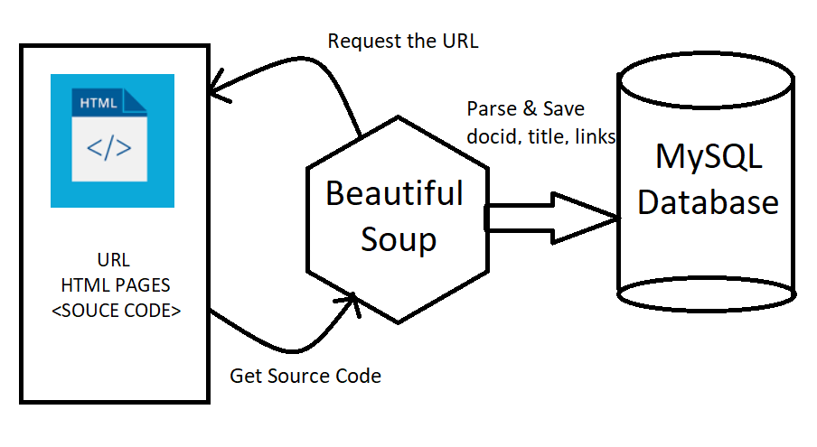
3. ARCHITECTURE OF THE SYSTEM

Slide 6
4. Data extraction steps (A pseudo code)
Open the URL using the open method from the request package.
Open a connection with the MySQL database.
Get and parse HTML content using an external parse LXML parser → This provides the actual HTML content required for data crawling.
Just get the Hyper Links which have all the necessary data. If the link is in “valid format”, get the link and extract the docid, title and href.
For every extraction invoke the cursor to insert the gained data in database. (‘for every href’ insert into database).
Perform the same operations for a web page possessing top rated Android Applications and save the data in the database.

Slide 7
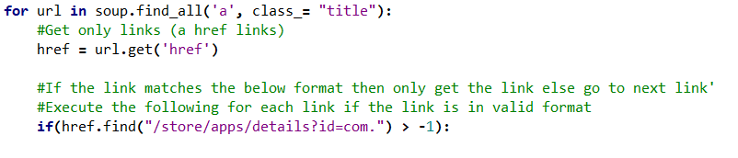
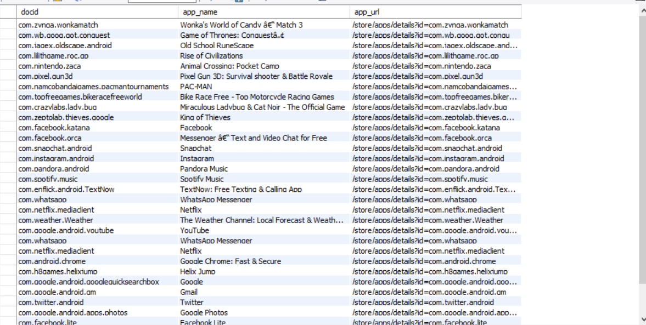
5. The code base (Work done till now)
The “a href” extraction for this kind of link.

Slide 8
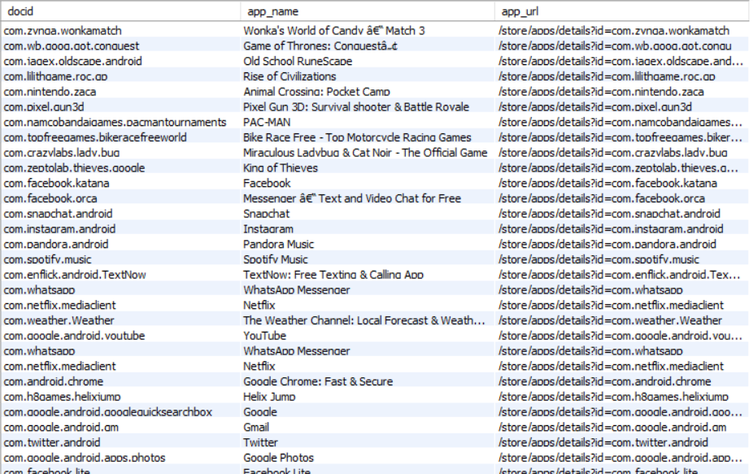
6. Future work (BRAINSTORMING)
Maintaining a datetime and the crawl_number stamp .
Managing old and new app data for every crawl event execution.
Update the crawl number by 1 or some value if the app is found.
If the app not found, remove and insert into new table with latest timestamp available. A table of old ranked apps.
Also maintain the timestamp and number of hits for the ‘url’.

Slide 9
Thank you
A Presentation by G-miners
Group member: Govind Yatnalkar
Mentor/ guide: Dr. haroon malik
Date: November 8th 2018
College of engineering & technology Marshall university

